Slide 1
FITCOIN
Low-Fi Testing
Dylan Plautz | Caroline Frost | Nick Mayhew

Slide 2
OVERVIEW
01
MISSION
02
UI PROTOTYPE AND TASKS
03
LOW-FI TESTING
04
RESULTS AND SUMMARY

Slide 3
MISSION STATEMENT
Provide a fun alternative for those who feel alienated and intimidated by fitness. Helping adults who are short on time and motivation to reach their long-term health goals through social gaming.
FUN FITNESS FOR ALL!

Slide 4
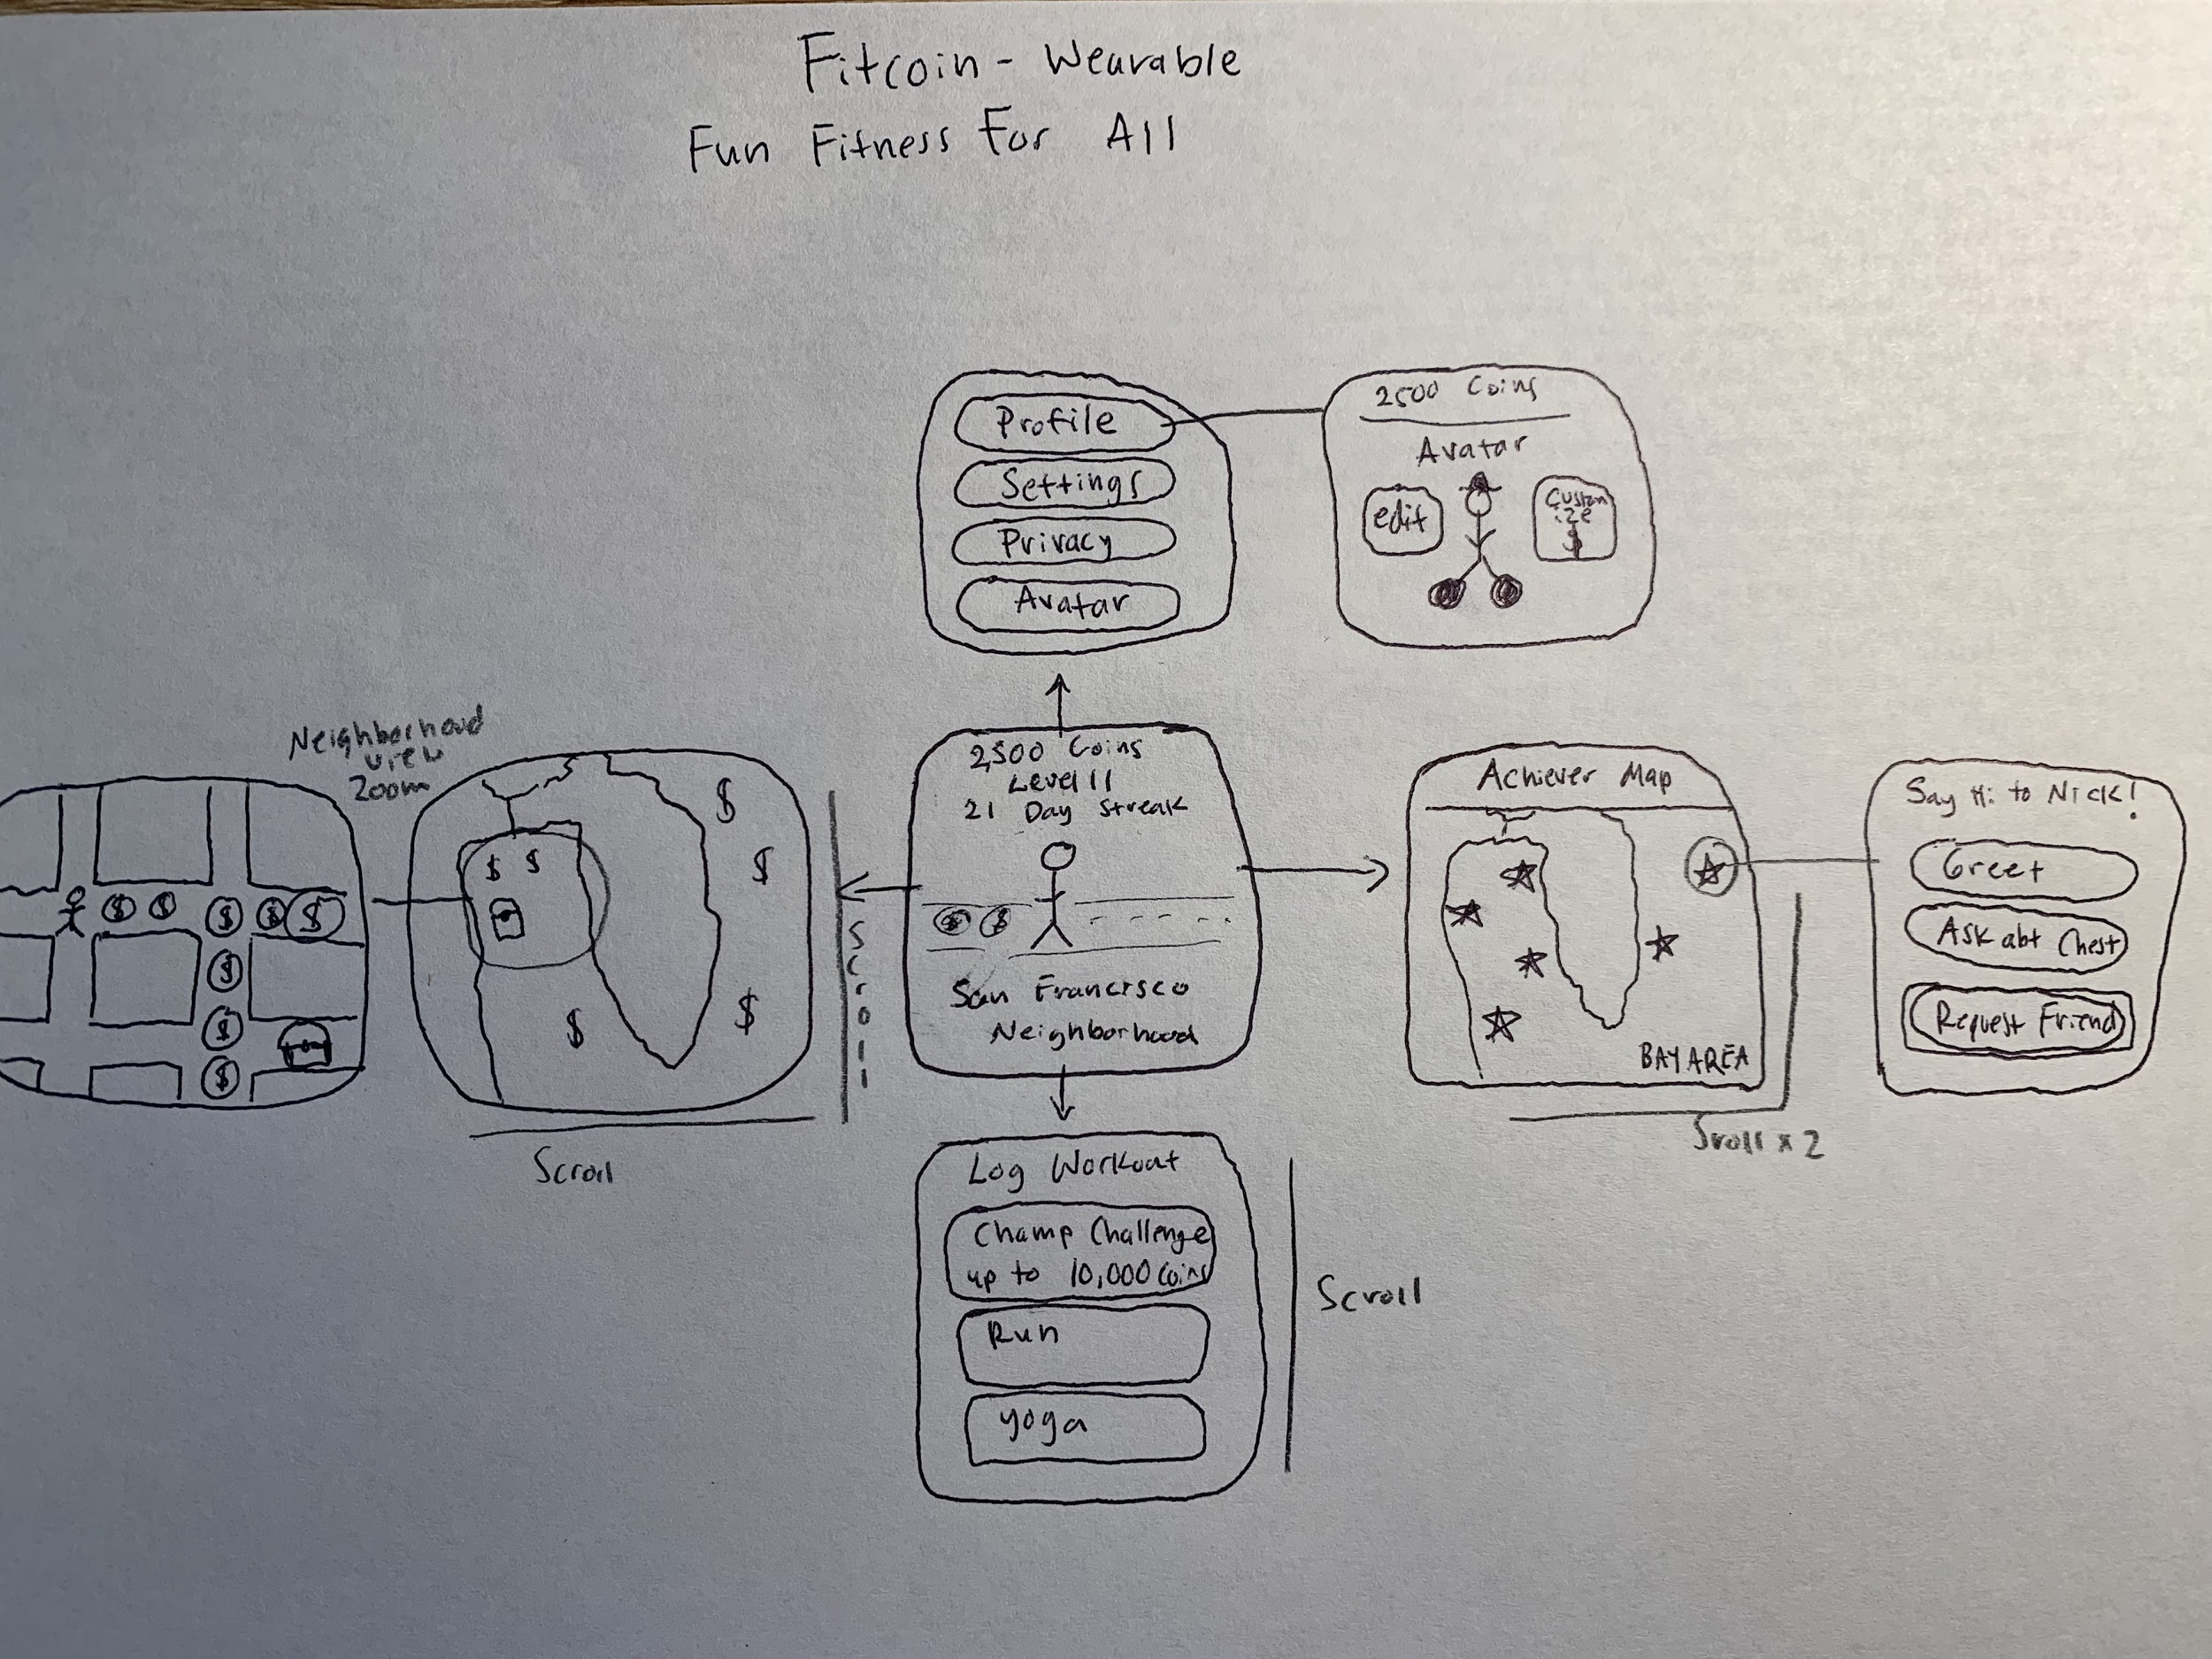
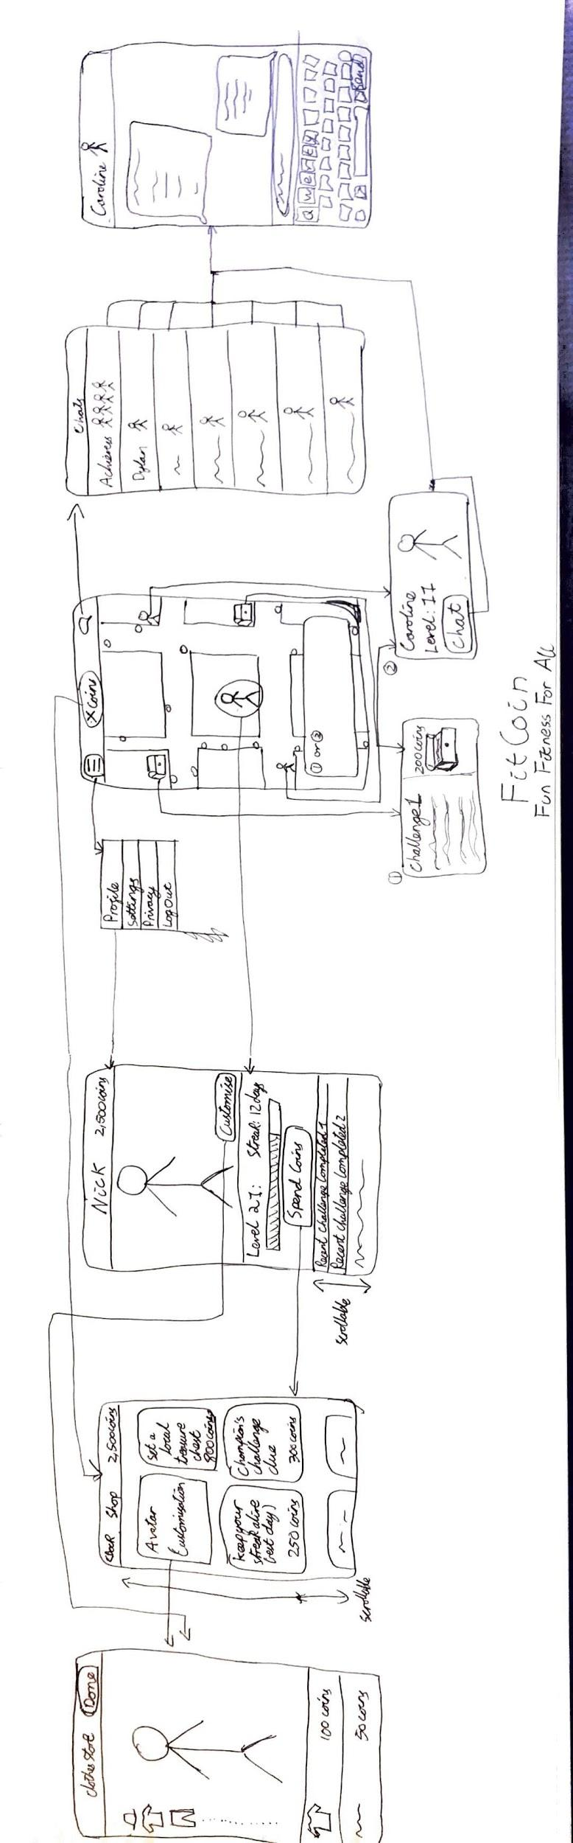
INTERFACE?
Wearable
Mobile

Slide 5
SELECTED INTERFACE
MOBILE
More flexible interface
Better for complicated functions like chat, map, and rewards.
Mobile tech is the most accessible

Slide 6
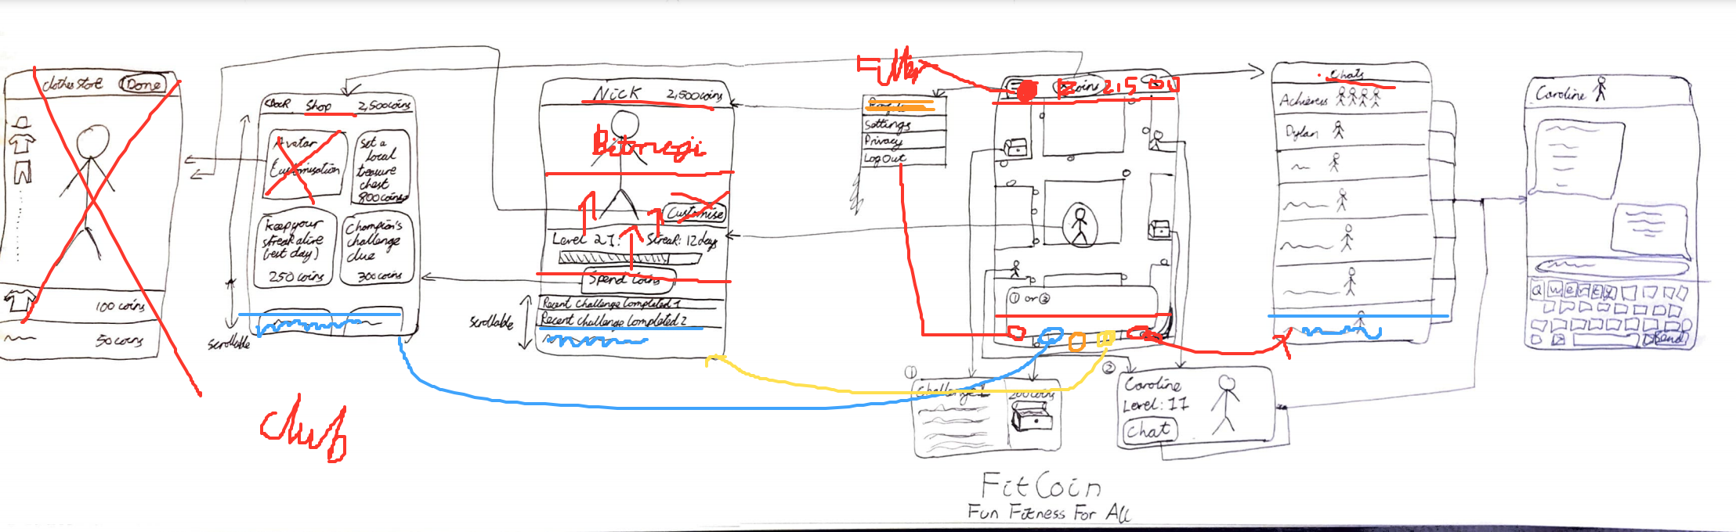
MOBILE UI ITERATION

Slide 7
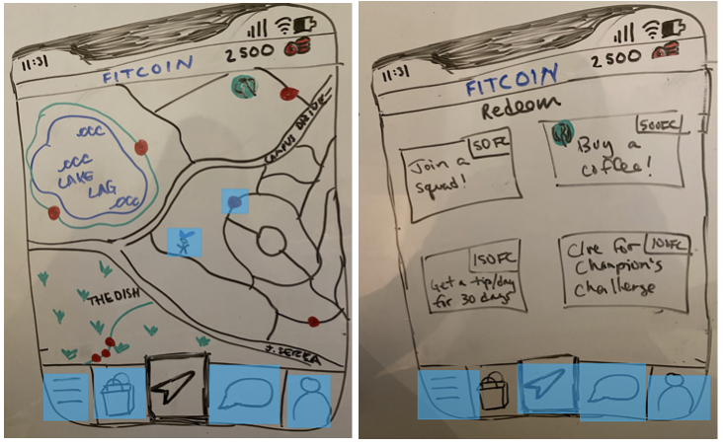
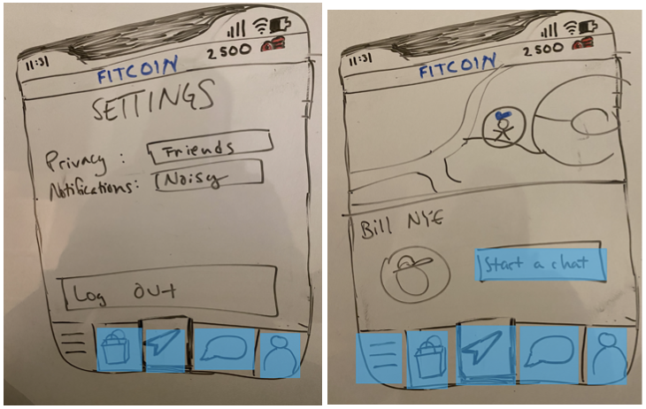
PROTOTYPE STRUCTURE
Uses InVision to mimic user interaction
The blue highlighted portions are interactive, modeling basic tasks

Slide 8
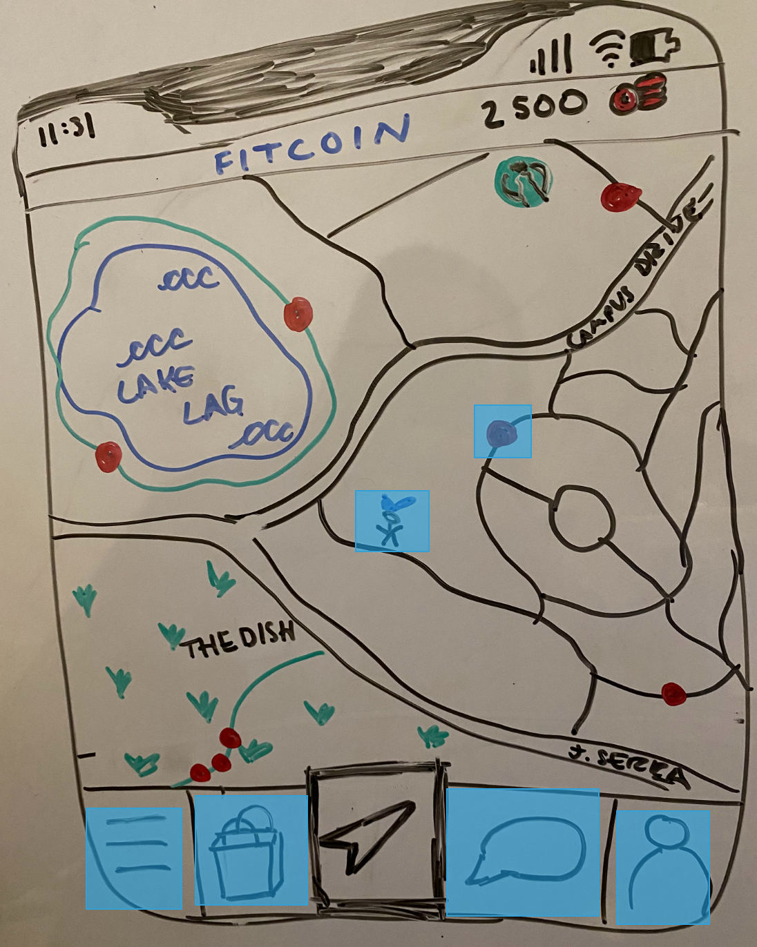
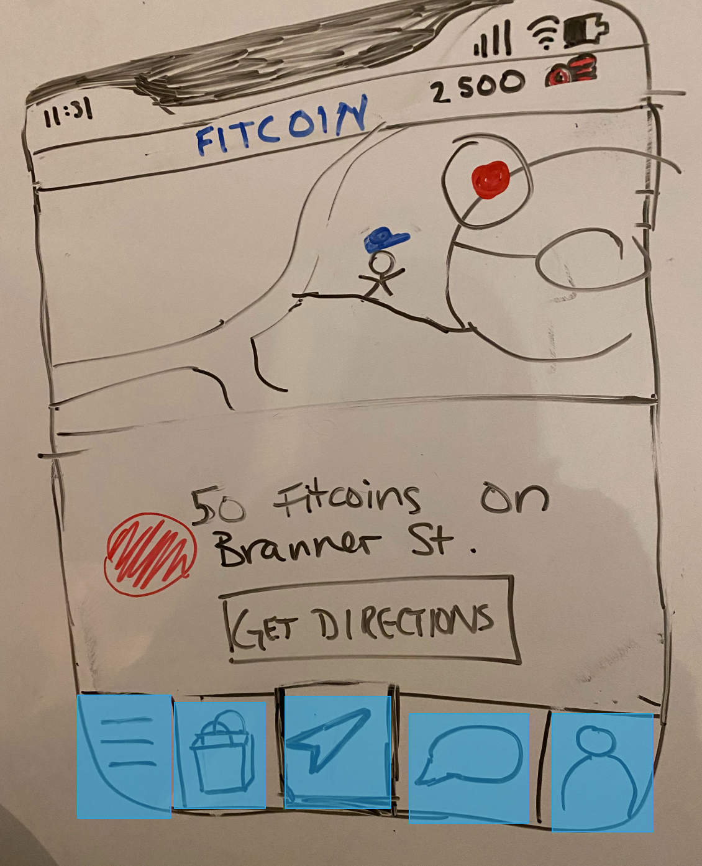
SIMPLE TASK
TASK: FIND A FITCOIN

Slide 9
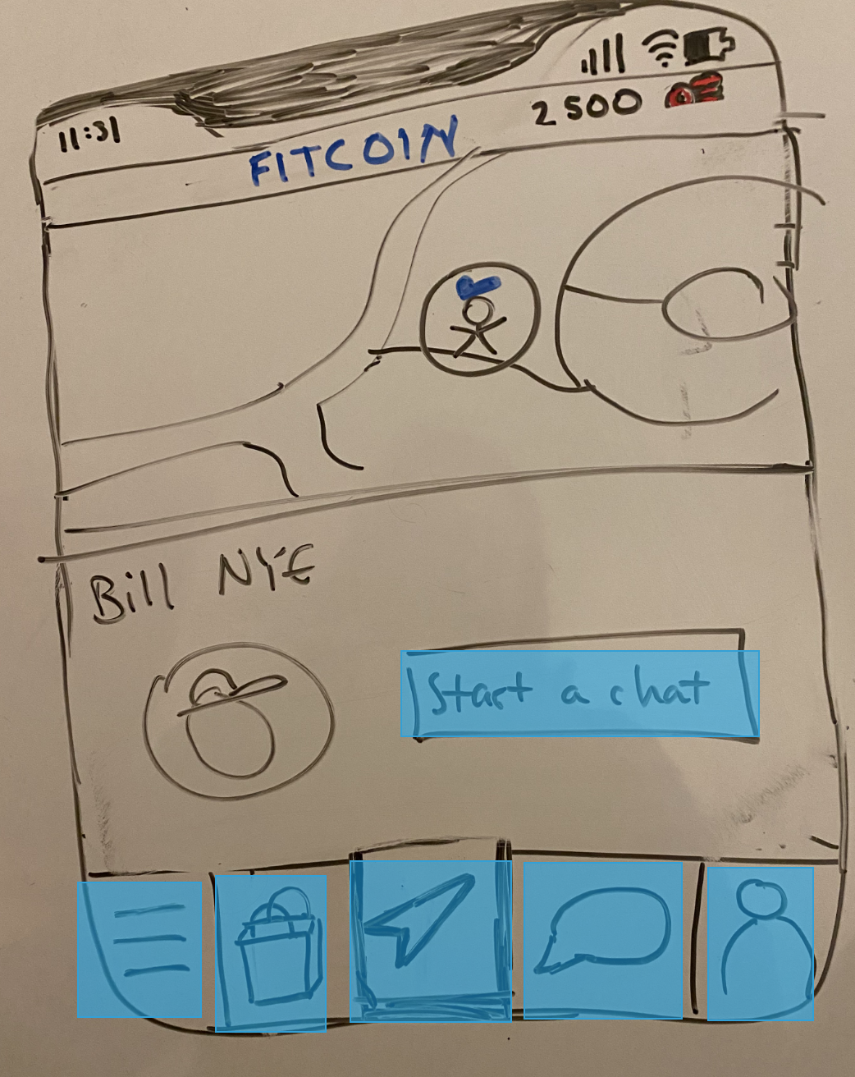
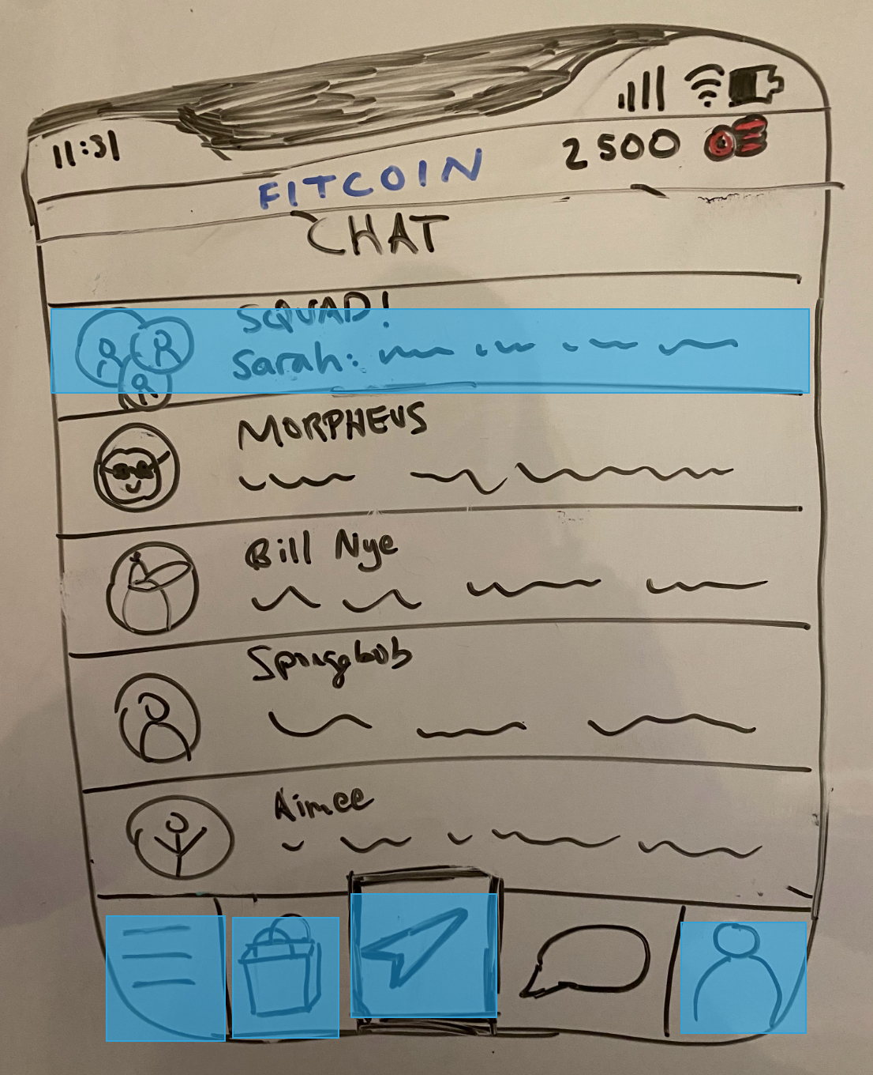
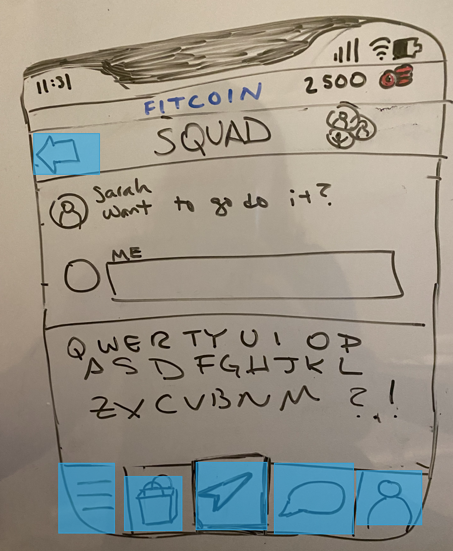
MODERATE TASK
TASK: CONNECT WITH YOUR COMMUNITY

Slide 10
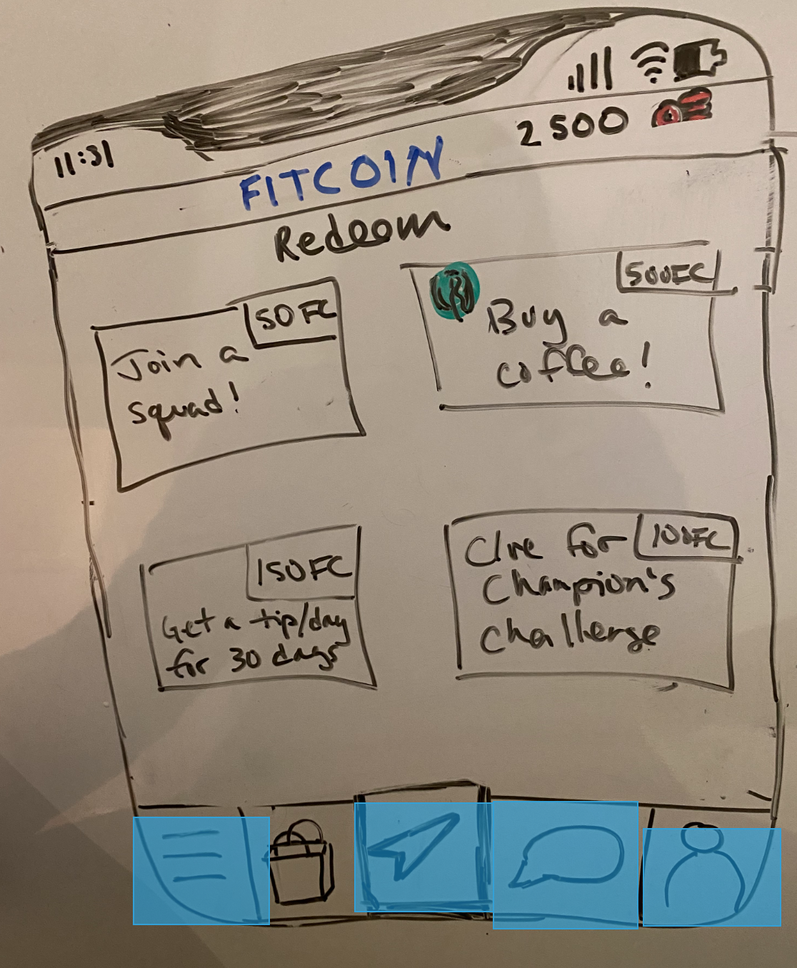
COMPLEX TASK
TASK: SPEND COINS ON A REWARD

Slide 11
PARTICIPANTS AND METHODS
HN
JM
DN
Each test was conducted virtually with audio and screen recording.
Each user attempted three basic tasks, as we noted positives, problems and mistakes.
23 year old small business owner
Middle-aged woman, involved in her neighborhood community
Middle-aged man, former athlete trying to get back into fitness

Slide 12
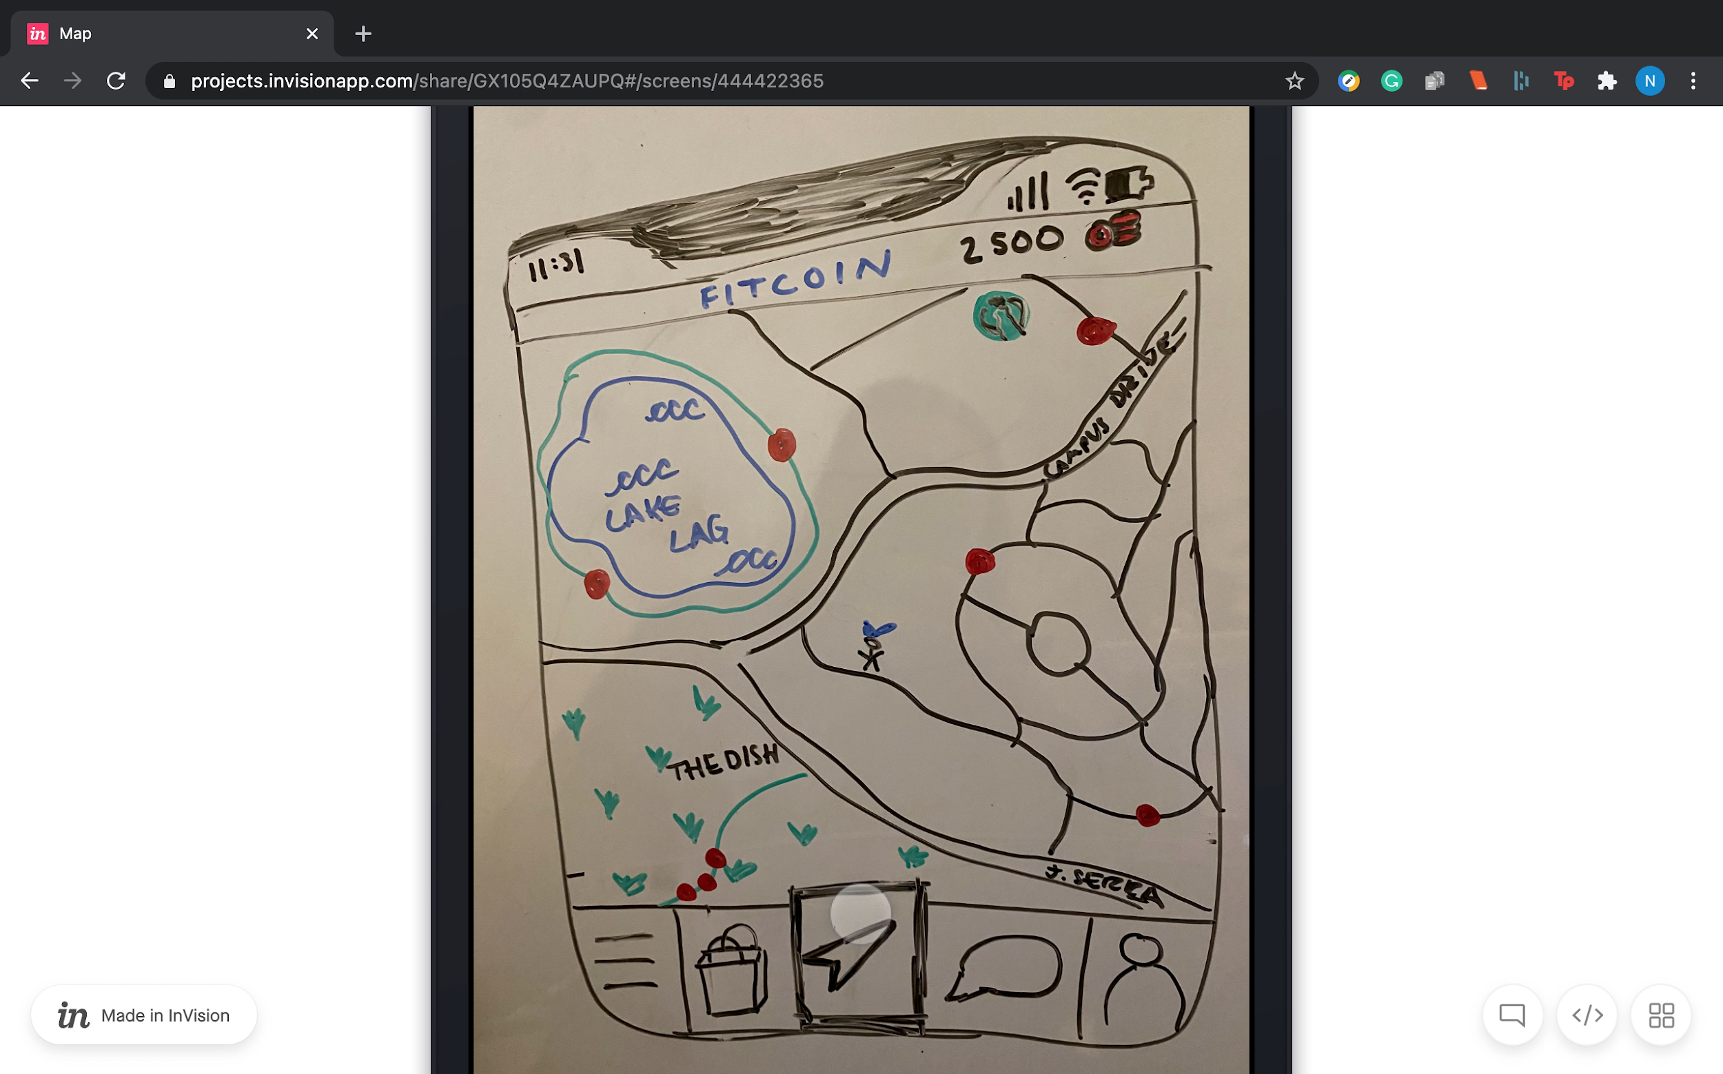
RESULTS
THE TASK OF FINDING A COIN WAS SLOWEST FOR ALL USERS
Determining how to find a coin took multiple tries.

Slide 13
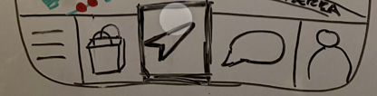
RESULTS
COMMON ICONS LIKE CHAT WERE INTUITIVE - BUT OTHERS WEREN'T
Familiar icons made task two and three easy, but, our home/map icon slowed down some users.

Slide 14
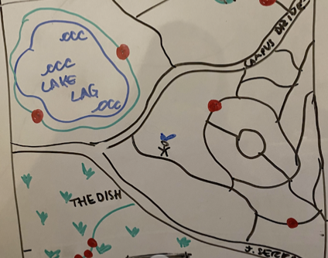
RESULTS
USERS NEEDED HELP UNDERSTANDING THE AR ASPECT OF THE APP
They weren't sure how to interpret the map of Stanford or their own location.

Slide 15
SUGGESTED UI CHANGES
ONBOARDING AND HELP
NAVIGATION ICONS
COINS SHOULD BE EMPHASIZED
Add onboarding and have help options to explain the features
The home/map icon needs to be altered to make it intuitive
Our simple task needs to be the easiest to complete and should be one of the first reads for the user.

Slide 16
SUMMARY
Fitcoin strives to make fitness fun for all, combining gamification, fitness and community.
The app can be confusing for some, so a help feature and an onboarding sequence should be included.
The function of finding coins needs to be simpler and more intuitive by being emphasized in design.
Users were excited by the product, despite the conceptual barriers.

Slide 17
QUESTIONS?

